Slide 1
Creating a Resume
Job Readiness Workshop 6
Notes:
The objective of this workshop is for the youth to learn what a resume is, as well as taking the skills they have identified throughout other workshops to actually create a resume for themselves. Many youth have not had employment opportunities, so teaching them how to bring skills and experiences from other areas of life to create a resume will be necessary.

Slide 2

What is a Resume?
Notes:
Discuss with the students what they think a resume is and what it is used for. If any of the students have a resume, discuss who helped them with it and how they save or access it for future use etc.

Slide 3
Resumes
A marketing tool that showcases your qualifications for a particular job
It shows an employer your experience, skills, & knowledge in an easy to read format
A resume can answer many questions for an employer, including
  “Why should I hire this person?”
  “What can this applicant do for me?”
  “What does this applicant have, that no one else does?”

Slide 4

Developing A Resume
Basic Resume Sections
  Contact Information
  Career Summary
  Skills & Qualifications
  Experience
  Education & Training
Notes:
Explain the basic sections of a resume.
Explain that this is one of many ways to organize a resume. There are multiple ways and options but we are going to stick to this basic set up for the purpose of learning a basic resume.

Slide 5
Contact Information
Name
Address
Phone Number
Email address
*Make sure all information is accurate*

Slide 6
Things to Remember With Contact Info
Voicemails
  Inappropriate vs appropriate voicemail greeting
Emails
  Keep emails simple and professional
  Recommendation: have a separate email for job searching
    johnsmith@gmail.com vs candycrush2015@gmail.com
Notes:
Discuss the different professional recommendations and why they are important if you are looking for a job.
Voicemail examples: Employers do not want to hear cool rap songs or get pranked in a voicemail. Provide some examples of appropriate options. “Hi this is John Smith. Sorry I cannot come to the phone but please leave a message and I will get back to you as soon as I can, Thank you for calling”.
Email Examples: Employers want professional emails and will make judgments based on email address names. We all have a junk fun email, but when we are job searching, it needs to be professional and needs to be checked often.

Slide 7
Lets think out of the box, for OTHER experiences I have ?
Home
Chores
Babysitting
Community
Volunteer work
Internships
School
Course work
Band
Lawn mowing
Music lessons
Dance class
Etc.
Religious activities
Job shadowing
Art classes
Theater
Languages
Honor society
Etc.
Sports
Etc.
Community events
Sports lessons
Coursework at School, Volunteer Work, Extra Curricular Activities, Job Shadows Etc.
Notes:
Recommended Activity:
Break the class up into 3 groups. Assign each group 1. Home, 2. Community, 3. School. Ask the students to brainstorm and share their involvement in volunteer work, coursework at school, & extra curricular activities at home.
Have each group choose a spokesperson to share with the group all of the skills and experience they came up with in that category. You could easily make it a competition by seeing who could come up with the most ideas in their category.
Students that don’t have a work history can benefit from this activity to start thinking about other areas of their life where they may have gained skills.

Slide 8

Writing a Resume
Resume Errors to Avoid
Elements of a Resume to Include
Poor spelling/grammar
Overstating your experience
Providing too much information
Being too generic
Multiple formats
Keywords
Clear, measurable successes
A cover letter
Notes:
Explanation of Errors to avoid
Poor spelling/grammar — Don't depend just on your software's spell-checker. Have someone read through your resume and look for incorrect spelling and grammar.
Overstating your experience — Your resume is meant to be a tool to sell yourself. Don't exaggerate your experiences.
Providing too much information — Don't crowd your resume with too much language. Add space to your text and make sentences into scannable bullets as much as possible.
Being too generic — When it comes to describing yourself and how you're a good fit for the position, be specific.
Explanation of elements to include
Multiple formats. Consider making two versions of an electronic resume: one that is text only with spacing to indicate new sections, and one that is formatted as you would like. You should also have a printed resume on hand to provide during interviews.
Keywords. Employers often use computer scanners to review resumes in order to weed out those that don't meet the minimum job requirements.
Clear, measurable successes. Be honest about your skills and work experience, but emphasize results.
A cover letter. In it, you can expand on why you're a great fit for the position and show any research you've done on the company.

Slide 9
Tom Jobseeker
365 Unemployment Avenue
Salt Lake City, UT 84129
tomjobseeker@gmail.com
(435) 555-1938
RESUME PROFILE
Outstanding student with experience in print and online journalism seeks opportunity to learn by doing while working with a communications, public relations, or publishing firm through a part-time job or summer internship.
EDUCATION
Completed three years at Hometown High School.
Graduation date: May 2016.
G.P.A. 3.85. Top 5% of class.
EXPERIENCE
Newspaper Staff Member, Copper Hills High School
Aug 2014 - present. Features editor of campus newspaper, responsible for award-winning design.
Aug 2013 - Aug 2014. Researched information for news articles using library and Web sources. Composed and edited informational articles, columns, editorials, and advertising copy.
Yearbook Committee Member, Copper Hills High School
Aug 2014 - present. Editor-in-chief of yearbook staff. Leader of design and publication teams from initial layout through finished product.
Aug 2013 - present. Yearbook staff member. Experience taking photographs, designing layout, and writing captions and sidebars.
RELEVANT HIGH SCHOOL STUDIES
Technical writing; advanced composition; debate; video production; computer classes providing knowledge of word processing, desktop publishing, and Web software.
HONORS, AWARDS, AND MEMBERSHIPS
U.S. Media Association Scholarship recipient
Scholarship based on academic achievement, community service, and campus participation and leadership in high school communications projects
and studies.
2014 Best High School Newspaper Design winner
Central State Regional Communications Contest, sponsored by the Communications Department, State University.
President of high school chapter of Future Communicators of America (FCA), 2014 - present
Member, 2013 - present.
Good Resume Example
Notes:
This is an example of a good resume.
Review the structure and outline with the students

Slide 10
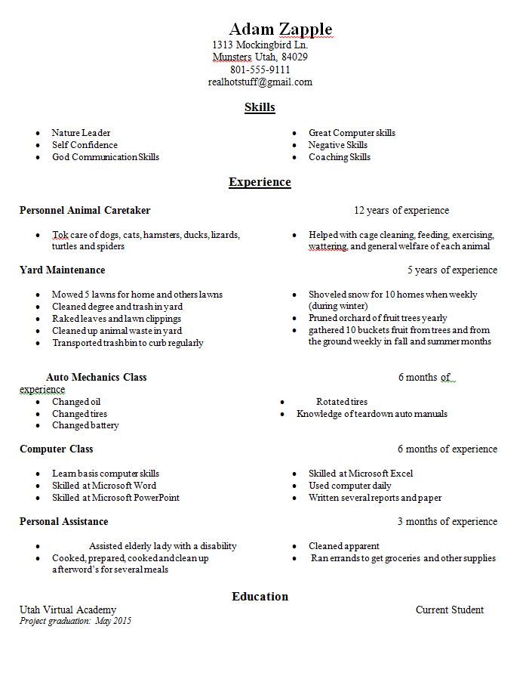
Bad Resume Example
Notes:
This is an example of a bad resume.
Have the students identify what is wrong with this resume.

Slide 11

References
People who can talk about your work experience, work habits, characters and skills
  Always contact them so they know employers may be calling them
  Do not list them on your resume
  References should be on a separate page that includes contact information
Notes:
Do students know what references are? Help them discuss who a reference is, and their role. Brainstorm people in their lives that can be references.

Slide 12

What is a Cover Letter?
Notes:
A cover letter is an introduction to your resumé and an opportunity showcase your skills, experience and qualifications and address certain employer requirements that are not included in a resumé; for example: If an employer requires being available on weekends or nights, you can address that in the cover letter or if the employer requests a salary history, again, the cover letter is the place to include a salary history.

Slide 13
Writing a Cover Letter
A good Cover Letter includes:
First Paragraph
    Introduction on who you are and why you are submitting your resume to a company
Second Paragraph
    Provide a summary of your skills and experience listed in your resume, and why you are the perfect match for a position
Third Paragraph
    Express your intentions with the company and your desire for an interview or meeting
    Express your thanks and how you are looking forward to meeting with the company, and will be following up with them in the future
Closure
    Salutation and signature
Notes:
Review the structure and items to include when writing a cover letter. Don’t forget the Why’s behind a cover letter and how it goes together with the resume.

Slide 14
Cover Letter Guidelines
Keep it concise, usually one page.
Ask a reliable source to read and edit your cover letter before you send it.
Use bullet points if you can, itemizing your skills or job experience.
Keep the formatting simple, using basic fonts.
Don’t forget to express your interest for the job and thank them for their time

Slide 15
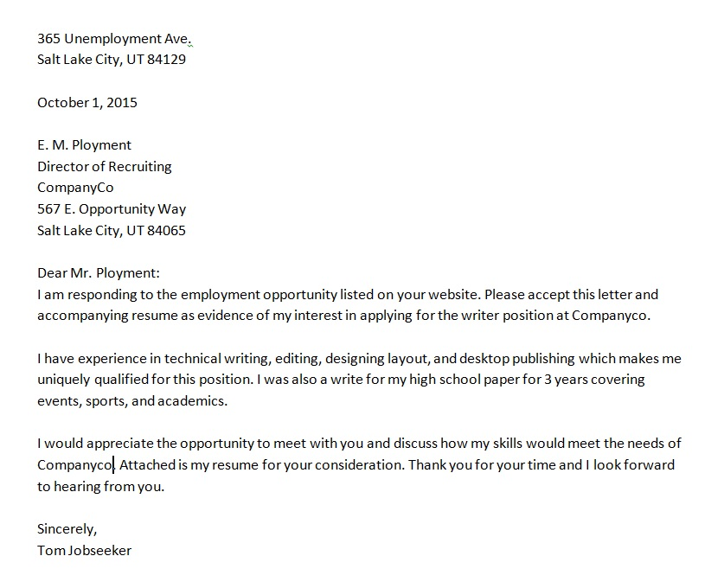
Cover Letter Example

Slide 16
How can my VR Counselor help me with Creating a Resume?
Provide guidance on coursework you can take while in high school that will aid you in your chosen career
Explore work experiences to help you gain skills for your resume
Help you and your teacher network to find relevant Job Shadow opportunities.
Develop, review, tailor, and improve your resume and help you write a cover letter if needed

Slide 17

Workshop 6:
Reflection Questions
Have you completed a resume?
What information will you need to gather in order to have a complete resume?
What to expect for Workshop 7…

