Slide 1
The Value of Work
Job Readiness Workshop 1
Notes:
Hand out the Student Workbooks and explain how they are a part of the workshop, and they need to write their names in them and use them throughout the course.
It would be a good idea to coordinate with the teacher on keeping track of the workbooks and completing the journals.
The objective of this workshop is to teach the students why we work, and the value of work. We work for a variety of reasons. These reasons are based on external and internal factors. Work has value, no matter what the job is. Helping the students discover their personal motivations for work is the foundation of the Job Readiness Workshop.

Slide 2

Why are you here?
Lets get to know each other!
Notes:
Counselor comes to class prepared with materials to do an ice breaker activity from the provided activities list, or one of their own.
The point of this is to learn who the students are and begin the process of understanding their motivations and who they are. If you don’t know the students names or things about them, how will you engage them throughout the rest of the 10 workshops?

Slide 3
Ground Rules
Use phones and technology as appropriate
Respect each other
Be on time, there is a lot of information
Come to each Workshop willing to participate
Weekly Workbook needs to be completed
Use positive language throughout Workshop
Ask questions!!!
Notes:
Counselor and class can add any additional ground rules that are needed in order for the students to learn and be better prepared for employment.

Slide 4

What can you expect to learn throughout the Job Readiness Workshop?
10 workshops
  Self-Discovery
  Job Readiness Skills
  Job Seeking Skills
  Job Keeping Skills
Notes:
Discuss how the workshops will work. Depending on the school, you may be in a certain class period each week, or maybe you meet in the library. Explain the time and location so the students know what to expect. Make sure this is clearly discussed with the teacher ahead of time.

Slide 5

Why Work? Activity…
People work for different reasons
It is important to understand your own motivation to work
Notes:
Possible activity:
Instructions: People work for different reasons and It is important to understand your own motivation to work.
Can you think of reasons why motivation is so important? Explain that motivation is what helps us take action and keeps us moving forward when the job becomes difficult. It’s like the fuel for a car.
Explain that in this activity they will identify the pluses (benefits) and minuses (drawbacks) to working. They will also think about the “cool” aspects of working.
Hand out the Why Work activity sheet.

Slide 6

What does it mean to value something?
  It has worth
  It has special meaning
  Can’t do without it
What do you value and why?
Notes:
We work for a variety of reasons. These reasons are based on external and internal factors. All work has value, no matter what the job happens to be.
Have the students generate ideas about what they value and why. (Example: I value my dog because he is a good companion). Does this meet the criteria for a value?
Review each item under What does it mean to value something?: has worth, has special meaning, can’t do without it.

Slide 7


What motivates you to work?
External
Internal
Notes:
Discuss the differences between external and internal motivations.

Slide 8




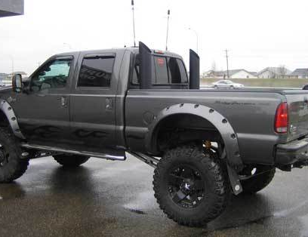
External...
NEEDS
Notes:
External Factors…. Needs: Food, housing, transportation, medical etc.
Ask students for additional examples.

Slide 9
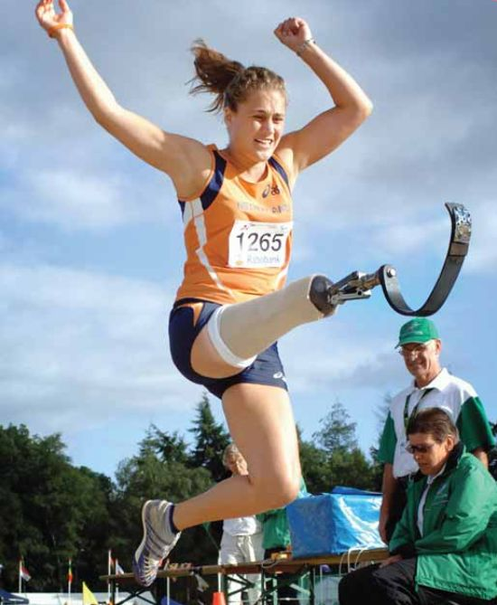




External…
WANTS
Notes:
External Factors…. Wants: Video games, movies, hanging with friends, sports
Ask the students for additional examples.

Slide 10




Internal…
Non-Tangible
Notes:
Internal Factors….non-tangible. What does that mean?
-Self-confidence
-Self-esteem
-Competency and promotions
-Skills development/improvement
-Social Interaction
-Awards/recognition

Slide 11
Pluses of Working!
Ideas…
  $$$ Money $$$ for: recreation, food, videos, rent, transportation, independence etc.
  Doing something! Get out of the house!
  *** Be productive*** What does this mean?
  Sense of accomplishment!
  Get my parents off my back ☺
  Other ideas…
Notes:
Have a group discussion about the pluses of Working. There is a worksheet in the activities that students can use for an activity.

Slide 12
Minuses of Working!
Ideas…
  Less free time: friends, video games, movies
  Fear of the unknown…
  New co-workers & boss that are not your friend ☹
  Keeping a schedule 
  Transportation concerns: bus, car, bike…
  Other ideas…
Notes:
Have a group discussion about the minuses of Working. There is a worksheet in the activities that students can use for an activity.

Slide 13

What are your strengths?
Strengths are:
  Talents
  Things you are good at
  Things you enjoy doing
Notes:
Possible Activity: Strengths Identification (in activities list)
Give a brief explanation of strengths as listed on the slides and explain that everyone has strengths. Hand out the strength identification sheet found in workshop 2 activities folder. Have students work individually on this activity and provide assistance as needed. You may need to explain some of the unfamiliar words.
Instruction:
-Circle all of your strengths that you can identify on the worksheet.
-Add additional strengths in spaces provided and in appropriate categories (Help students identify the correct category or use “other” column).
-Identify your top 5 strengths by circling them. Have students transfer their top 5 skills on their personal inventory sheet.
If time permits, you could have a discussion about the categories of strengths. Use the following explanations: Realistic=Doing Strengths, Conventional =Organizational Strengths, Social=Helping Strengths, Artistic=Creative Strengths, Investigative=Thinking Strengths, Enterprising=Persuasive/Leadership Strengths, and the Other category is for personal strengths that may fit in several categories. You may ask them to count the items circled and tally each category to see if there are any distinct strength areas.

Slide 14

All Work Has Value….
Work involves certain expectations, which are necessary for success!
Accepting the Role of the Worker
Mental Aspects of Work
Social Interactions
Physical Aspects of Work
Example: Custodial Work
Notes:
Discussion: Why does all work have value? How does a custodial worker contribute to a business and how can you progress in a career?
Expectations add value to because when we comply to these expectations, it means that we are doing a good job and are a valuable employee.

Slide 15
Work Expectations…
Role of the Worker
Mental Aspects of Work
Attendance
Following Work Rules
Attending to Tasks
Following Instructions
Correcting Errors
Personal Appearance
Positive Attitude
Taking Initiative/ Independence
Adaptability
Accepting Responsibility
Handling Stress/ Focusing
Ability to Learn
Notes:
Role of the worker: This is a short list of what it means to accept the role of a worker. Present each item and have the students provide meaning to each item. Provide help if needed. Ask if they can you think of other expectations. Discuss expectations of personal hygiene on the job (grooming, brushing teeth, bathing, cleanliness, wearing clean clothing that are in good repair, and deodorant)
Mental Aspects: Use the following examples or come up with your own
*Positive Attitude: Having a good outlook about the job, being happy to be there, having confidence in your ability to perform the job, and energetic about being there or performing tasks
*Taking Initiative/Independence: seeing what needs to be done and doing it, confidence in making decisions, following through with tasks without needing constant supervision
*Adaptability: Flexible, able to move from one task to the next, open to change
*Accepting Correction/Responsibility: taking feedback about your performance, being reprimanded for work not done correctly, being responsible for your work (good or bad).
*Handling Stress/Focus: handling the demands of the job such as speed and quality, being able to stay focused on the job, and being able to refocus when pulled away from a task.
*Ability to Learn: Teachable, acceptance to instruction, being able to remember past information and add new information. Accommodations can be made in this area from a job coach or through adapted instruction through an employer.

Slide 16
Work Expectations…
Appropriate Social Interactions
Physical Aspects of Work
With Supervisors
With Co-Workers
With Customers
Communication Style
Performing Work Tasks
  Quality
  Quantity
  Physical Tolerance
  Work Skills
Notes:
Social Interactions: Briefly discuss expectations around appropriate social interactions with the following. Sometimes we can take feedback better from a supervisor than from a co-worker. What does it appropriate communication mean? Have a discussion about the difference between professional and personal communications.
Physical Aspects: Employers expect that you will be able to perform the required work tasks associated with the job. (example: A cashier position may require the following: money handling experience, ability to run a cash register, excellent customer service, and reconciling the register).
*In performing these tasks, employers will expect a certain quality or standard. The standard on the example above is “excellent” customer service.
*Quantity refers to the number of tasks done in a certain period of time. (example: cashier will perform 100 transactions per 8 hour shift)
*Physical Tolerance: Employers expect that you will be able to stand, sit, walk, and lift depending on the job. Some jobs can be modified to address physical restrictions.
*Work Skills: From cashier example the following are the skills: money handling, cash register skill, customer service, and counting/reconciliation of cash register.
Discussion other examples, if time is available.

Slide 17

How does this all help me go to work?
Notes:
Remind students that it is important to understand their strengths and skills so that they can:
Know what jobs they qualify for and will do well with
Develop a good resume
Talk to an employer about their strengths and skills in an interview
Know what skills they may be lacking and work to improve on them
Develop healthy self-confidence and self-esteem

Slide 18
How can my VR Counselor help me understand the Value of Work?
Individualized counseling and guidance
Personalized vocational planning
Provide activities that can help discover values, interests, and motivations
Assist in finding work experiences and training programs to help discover my strengths and abilities
Notes:
Provide any examples that can show them how you can help with these areas.

Slide 19

Workshop 1:
Reflection Questions
What did you learn about the Value of Work?
Why do YOU want to work?
What to expect for Workshop 2…
Notes:
*Direct them to their Student Workbooks and go over the Reflection Questions…..
Ask them to fill them out in their journals. They can get help from their teacher, parents, friends, siblings or anyone they need help from.
If they have difficulty writing, this may be an opportunity to practice, get help, or they can find a creative way to answer the questions. It does not have to be through writing.
*Prepare them for next week: Topic, time, location, bring books etc.

