Slide 1
My Skills & Goals
Job Readiness Workshop 4
Notes:
This workshop instructs students on the difference between soft and hard skills and helps them identify their skills in these categories. Students will also learn basic goal setting.
Don’t forget: ALWAYS review what was covered in the previous workshop.
The objective of this workshop is to teach the youth the difference between ‘hard’ and ‘soft’ skills. This can be a confusing topic for many youth, but does play an important role in the success of employment. This workshop provides opportunities to help the youth discover their personal skills, and the skills they need to improve. The concept of ‘goal setting’ is taught in alignment with improving skills. Helping the youth set specific, measurable goals will help prepare them for the world of work.

Slide 2
What’s the difference?
Soft Skills
Hard Skills
Notes:
Understanding your soft and hard skills are important aspects of finding and maintaining employment. Once you can identify what your skills are, you can understand what skills need improvement.
Hard Skills are measurable and observable such as:
Typing 45 wpm
Folding 4 towels per minute
Soft Skills are more subjective and relate to people skills such as:
Getting along with others
Communication skills

Slide 3
What Employers Expect?
Employers can teach you hard skills
Employers expect you to have soft skills
Generally, people lose their jobs due to lack of soft skills
Notes:
Employers can teach you hard skills but they expect you to have the soft skills.
While employers often look for hard skill when looking to hire someone, it is usually the lack of soft skills that will get you fired from a job.
Hard Skills examples:
Typing speed
Machining skills
Speaking a foreign language
Cash register experience
Kitchen skills (food safety, knife skills, etc)
Knowledge of computer programs such as excel, word, power point

Slide 4
What do employers look for in job candidates in regard to soft skills & qualities?
Ability to work in a team structure.
Ability to make decisions & solve problems.
Ability to plan, organize, & prioritize work.
Ability to verbally communicate with persons inside & outside the organization.
Ability to obtain & process information.
Ability to analyze quantitative data.
Technical knowledge related to the job.
Proficiency with computer software programs.
Ability to create and/or edit written reports.
Ability to sell or influence others
(Source: Job Outlook 2014, National Association of Colleges and Employers)
Notes:
A list of these skills are in the appendix of the student workbook.

Slide 5
Identifying MY ‘Hard’ & ‘Soft’ Skills
Student
Soft Skills
Hard Skills
Notes:
Choose an activity that will help students personalize this information. There are some possible activities in the activity lists.

Slide 6
Basic Goal Setting
If you want to achieve something, you will be more successful if you write it down.
Notes:
If you want to achieve something, you will be more successful if you write it down. People can always find areas they need or want to improve. These areas could be in your personal life, employment, education, personal wellness or spirituality.

Slide 7
Why Set a Goal?
A plan helps you set a direction and stay focused
A plan helps you move forward versus going in circles
Having a plan in place makes it easier for the people around you to support your goals
Notes:
Explain: Have measurable goals!

Slide 8
How Do I Set a Goal?
Understand the difference between short and long term goals
Identify your short and long term goals and how they relate to each other
Outline the steps needed to achieve each goal
Identify how you will achieve each step
And now you have a PLAN!!!

Slide 9
Examples of Steps and Goals
Identify a measureable goal
Example: I will graduate from High School in May 2015
What information do you need, before you can reach this goal?
Example: graduation requirements, credits completed etc.
Identify the steps needed to reach the goal
Example: pass science, do not miss any days of school etc.

Slide 10
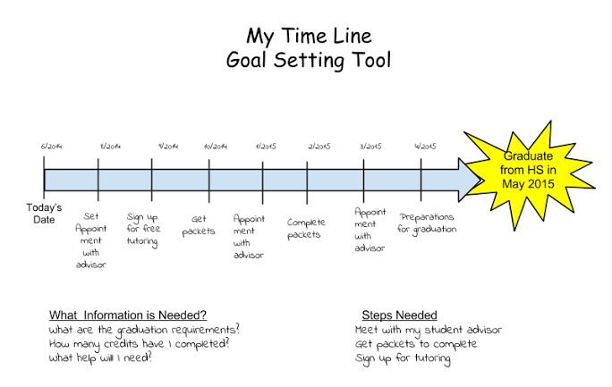
Notes:
Example of goal setting
This is a great time to do a Goal Setting Activity with the class, to let them practice what they just learned. You could create blank goal sheets like this one for students to make their own.

Slide 11
Self Improvement!
Self-improvement goals can be made to help people get ready to work:
Personal
Employment
Education
Wellness
Spiritual
Notes:
Possible activity: Have the group come up with a goal from one of the 5 categories. You can use the white board or chalk board in the classroom. Lead a discussion with the class.
Personal: making friends, better communication, strengthening relationships
Employment: hard or soft skill development, finding and keeping a job
Education: HS Diploma, GED, higher education, workshops, personal learning
Wellness: eating healthy, exercise, portion control
Spiritual: obtaining personal peace, religions worship, meditation
Can you think of other categories?

Slide 12
How can my VR Counselor help me identify My Skills and make appropriate Goals?
Individualized counseling and guidance
Work with you, your teacher, your family and anyone else you want, to help set your goals
Provide activities that can help identify your current skills and ways to gain needed skills
Practice goal setting, and help you stay on track with your goals for education and employment

Slide 13
Workshop 4: Reflection Questions
Are there hard and soft skills I need to improve or develop?
What are some barriers that I will need to overcome, or need assistance to overcome, in order to reach my goals?
What to expect for Workshop 5…
Notes:
*Direct them to their Student Workbooks and go over the Reflection Questions…..
Additional questions that could be discussed if needed: What will I gain or how will my life change if I reach this goal?
Are there consequences if I don’t reach this goal?
Are there barriers that might exist to reaching my goal and what will I need to do to overcome these barriers? (Disabilities related issues, financial issues, support issues)
Who will be your cheerleader? Someone who will support you in reaching your goal? (teacher, parent, friend, VR Counselor)
*Prepare them for next week: Topic, time, location, bring books etc.

