Slide 1
Making a Good Impression
Job Readiness Workshop 5
Notes:
The objective of this workshop is to help youth understand the concept of personal appearance and how to make a good first impression with an employer. The workshop teaches what an introductory speech (30 second commercial, elevator pitch, etc.) entails, and provides the opportunity for each youth to create and practice their introduction.

Slide 2

What does ‘Making a Good Impression’ mean?
Smile
Appropriate clothing
Do not use slang
Good posture
Ask good questions
Be confident
Other suggestions?
Notes:
Discuss what Making A Good Impression means. Why does this apply to students?

Slide 3

How Do I Make A Good Impression?
30 Second Commercial
Elevator Pitch
Introductory Speech
Elevator Pitch: Video
Notes:
*Make sure you test out the video before hand if you plan on using it. Because of technology, internet, computers etc, you may have issues or need to download or need a back up plan* * https://www.youtube.com/watch?v=CHaoDDZbDVY&feature=youtu.be (link, incase hyperlink in bottom right corner of slide does not work)
Discuss options for making a good impression. Have the students ever heard of an Introductory Speech? 30 second commercial? Elevator Pitch?
One of the keys to successful interviewing and networking is to make a really strong first impression. One of the first opportunities to make this impression is often in response to the question “Tell me about yourself”. The answer is your personal introduction. It is essentially an overview of your experience, skills, strengths, accomplishments and goals – all in 30 seconds!
Then play the video that explains why its important, and how to do a successful 30 second commercial or elevator pitch. (if you have internet connection)

Slide 4
When Will I Use it?
You will use your 30 Second Commercial throughout your working life. Some examples are:
      At an interview
      In a cover letter to highlight your background and key abilities
      When calling employers or asking about jobs in person
      When introducing yourself to a potential employer at a job fair
What other opportunities could you use a 30 Second Commercial to introduce yourself?

Slide 5
What Should It Include?
A 30 Second Commercial generally includes:
    Introduce yourself
    Discuss your relevant work experience
    Discuss a strength or skill in which the employer would be interested
    Follow with an accomplishment or two that proves you have those skills
        School, work, volunteer, home, etc.
Notes:
Slides 5 and 6: Discuss the flow and topics for a 30 second commercial and why you would include each of these.

Slide 6
What Should It Include? (continued)
A 30 Second Commercial also includes:
    Describe your employment goal. What are you looking for now and/or in the future?
    Tell them how you can immediately benefit the company
    Finish with a “Call to Action”. What do you want the person you are talking to, to do for you? For example:
      Asking for a job
      Asking for a referral
      Asking for a business card or application
      Asking what classes you can take to improve your skills
Notes:
Slides 5 and 6: Discuss the flow and topics for a 30 second commercial and why you would include each of these.

Slide 7

Teacher and VR Counselor Introductions
What did you learn about your teacher?
What did you learn about your VR Counselor?
Notes:
You must prepare your teacher in advance to have a 30 Second Commercial prepared. Then provide the VR Counselor 30 Second Commercial. These are for demonstration to the class, but also to show them how much they can learn from a 30 Second Commercial and to see if they made a good impression on the students.
The next slides show and example of a 30 second commercial. Depending on time you could create a fake 30 second commercial as a class.

Slide 8
EXAMPLE: 30 Second Commercial
Hi, my name is ____________. I am a junior at _________ High School and am an excellent student. I have chosen elective classes in the are of culinary arts. Through these classes I have learned to plan menus, select quality ingredients for my recipes, and I have the skills of proper food preparation and cooking techniques.
I am especially good at baking and I have created desserts that have won classroom competitions. I have also learned to prepare and serve my dishes for groups, giving me real life experience. I plan to continue in this field in college and my goal is to become an Executive Chef one day.

Slide 9
EXAMPLE: 30 Second Commercial (cont.)
I would like to add to my experience and skills in professional cooking by working for your restaurant as a Prep Cook this summer. I believe I can contribute to your restaurants success and do a great job for you.
“Call to Action”: May I bring by a copy of my resume and schedule an interview with you?
Questions?

Slide 10

Activity
Creating MY 30 Second Commercial
Notes:
In the student workbook appendix there is an outline of a 30 second commercial. Have the students work on their own 30 second introduction, read it several times, then practice reading it to a partner, and finally to the whole group.
Questions to consider while writing your 30 Second Commercial.
1. What is your goal?
2. What experience or skill do you have that would help you to achieve that goal?
3. What accomplishment proves you have that skill or experience?
4. What are you searching for in a job?
5. How can you benefit the company?

Slide 11
Key Points to Consider!
Practice, Practice, Practice!
  Needs to sound natural
  Make it a conversation
Will you be remembered?
  You need to stand out from others wanting the same job
  Choose achievements that will show your personality
Be prepared to answer questions.
  Follow up questions could be asked about your introduction
“Call to Action” may vary and change
  Depends on what you are looking for (job, application, help, conversation etc.)
Notes:
Discuss and reiterate the importance of creating a truthful and successful 30 Second Commercial.

Slide 12
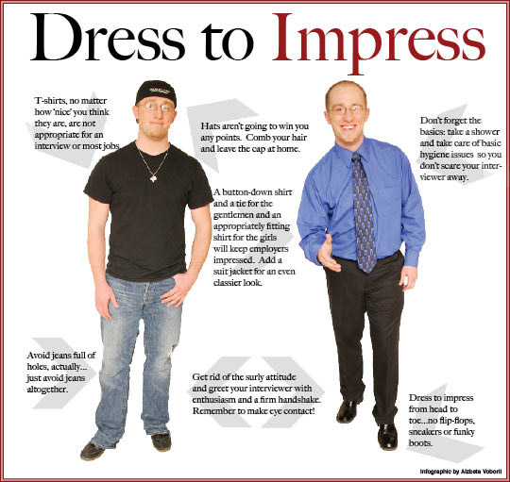
Personal Image
Notes:
Discuss Personal Image and Hygiene. Handout Personal Image Checklists for students to complete now or later and reflect on their own image. (This checklist is in the Student Workbook appendix)
-Remember, your impression begins when you arrive at the company. How you act in the parking lot, when speaking to the Receptionist, or to others in the lobby, as well as to the employers may determine whether or not you get the job!

Slide 13
How can my VR Counselor help me create my 30 Second Commercial and understand my Personal Appearance?
Create and practice your 30 Second Commercial
Create goals related to your personal appearance
Help you understand the difference between work clothing, interview clothing, and every day clothing
Help you build self-confidence in meeting new people and knowing what your strengths and skills are

Slide 14

Workshop 5:
Reflection Questions
How can I confidently present myself to others that may help me achieve my goals?
What can I change to help me get the job that I want?
What to expect for Workshop 6…
Notes:
*Direct them to their Student Workbooks and go over the Reflection Questions…..
*Prepare them for next week: Topic, time, location, bring books etc.

