Slide 1


Slide 2


Keywords
oNET Interest Profiler assessment
My Next Move activity
Pick Your Career activity
Review and sharing

Slide 3

Vocational assessment: Tool used to identify strengths, skills, aptitudes, interests, and vocational goals.
Occupation: A job or profession.

Slide 4
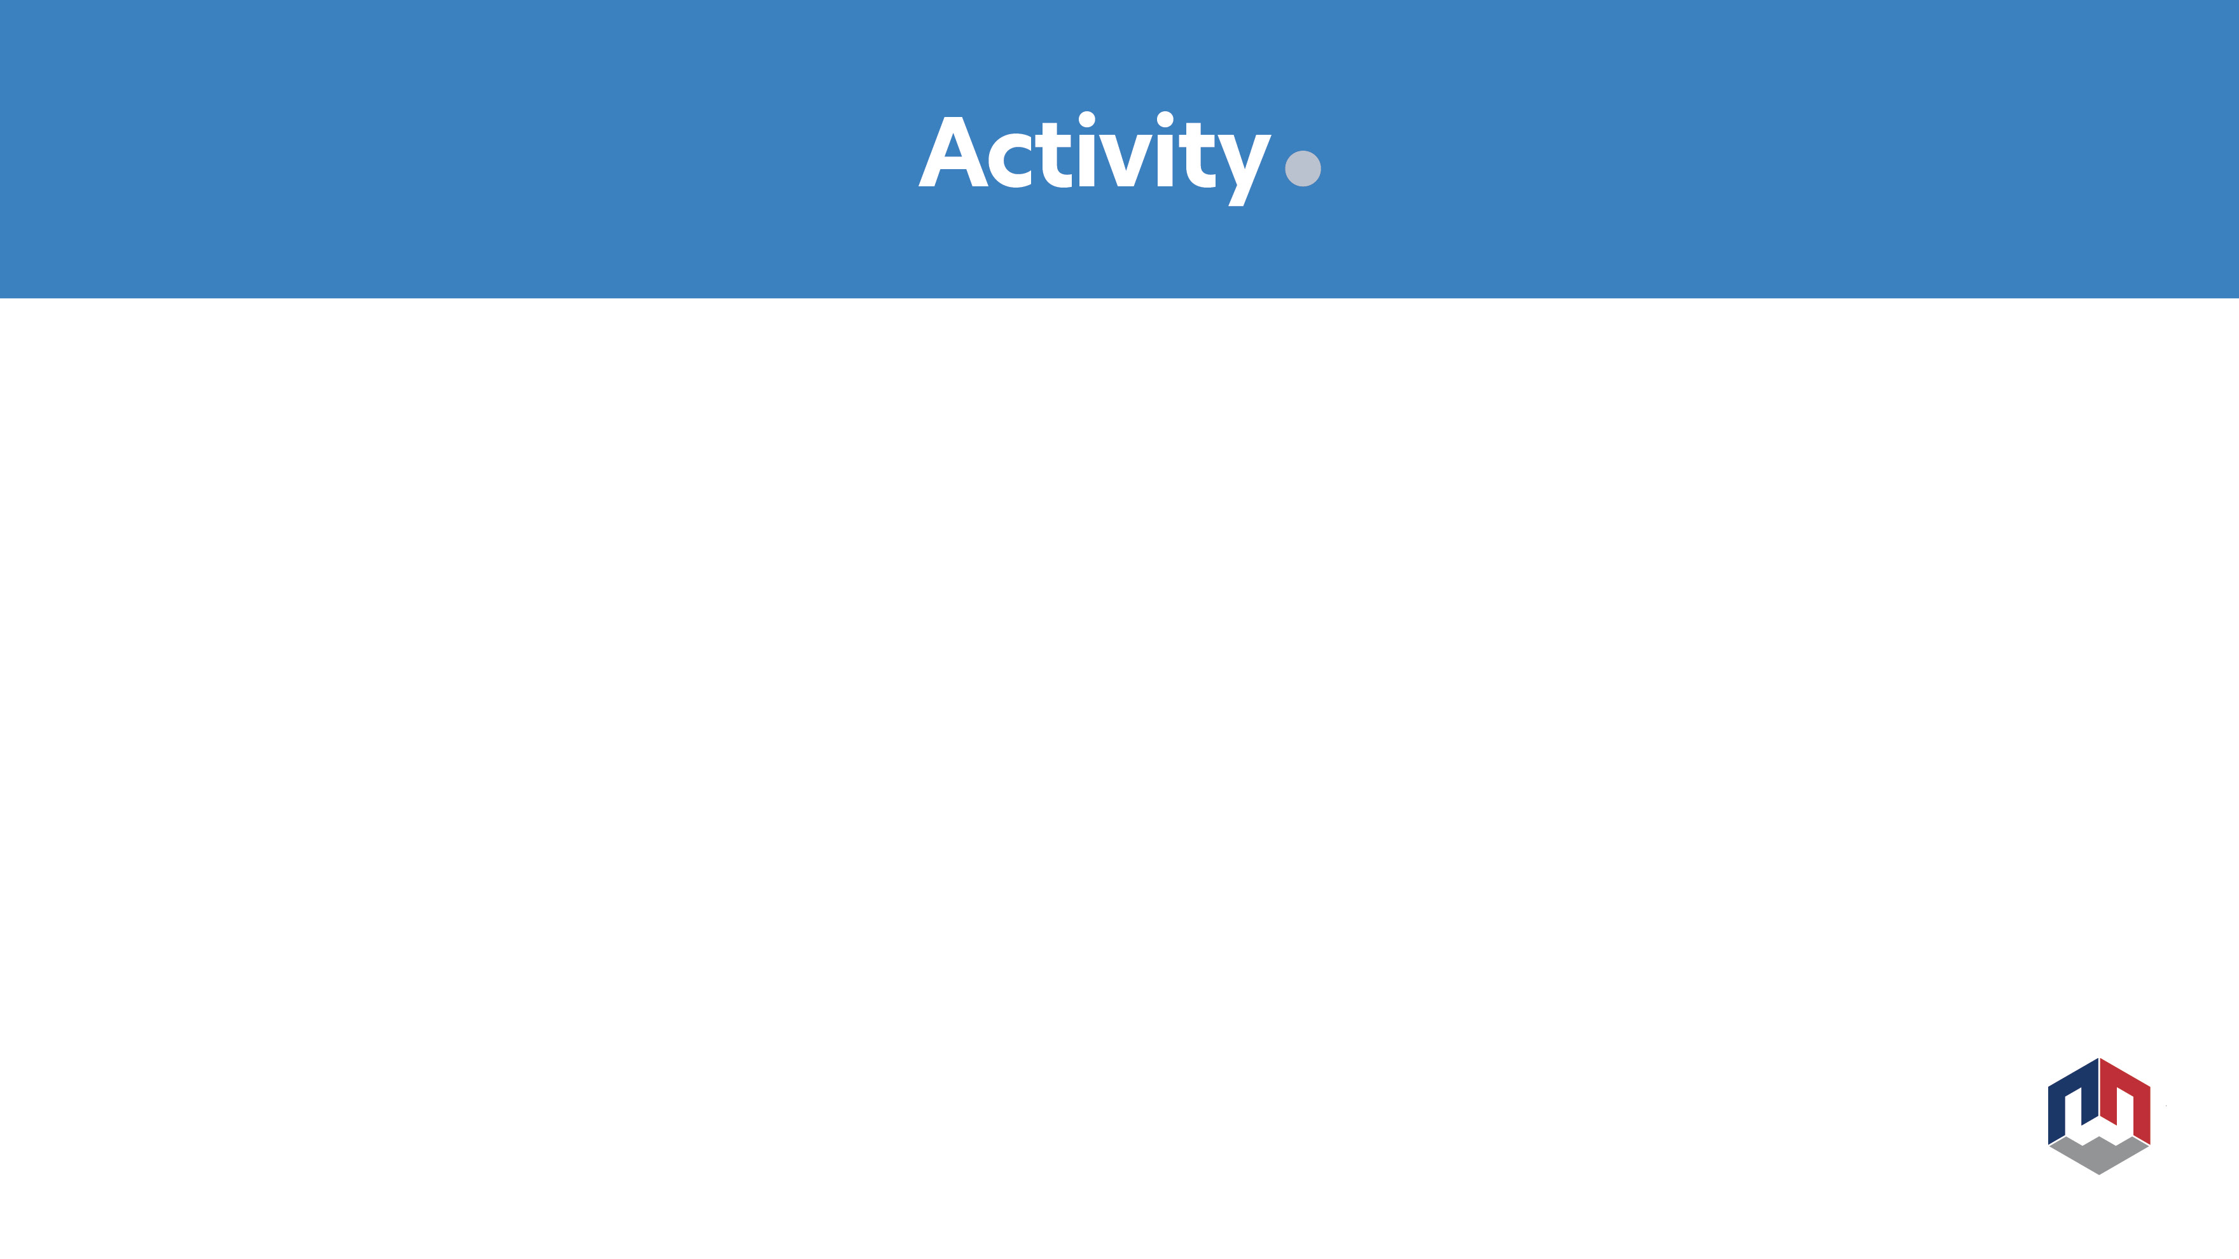

ONet Interest Profiler assessment:
Complete the 60 question survey at: https://www.mynextmove.org/explore/ip

Slide 5

Stand up
Put your hands in front of you about 12 inches apart with your index fingers pointing straight forward.
With your right finger, trace a “lazy” eight three times.
Put both hands in front of you again. Start with both fingers going up and cross your fingers in the middle of the “lazy” eight (like a choir director). Try this with some music!

Slide 6


Worksheet
List the different interest profile scores next to the category on the worksheet after completing the online survey.

Slide 7


Look at the pictures of different careers that are around the classroom and write your name on the picture you are most interested in as a potential career.

Slide 8


How can learning about work interest and aptitudes help in finding career options and pathways that are interesting to you?

Slide 9

Questions?
Name and email:

Slide 10


