Slide 1

Notes:
This workshop instructs students on the difference between soft and hard skills and helps them identify their skills in these categories.
The objective of this workshop is to teach the youth the difference between ‘hard’ and ‘soft’ skills. This can be a confusing topic for many youth, but does play an important role in the success of employment. This workshop provides opportunities to help the youth discover their personal skills, and the skills they need to improve.

Slide 2
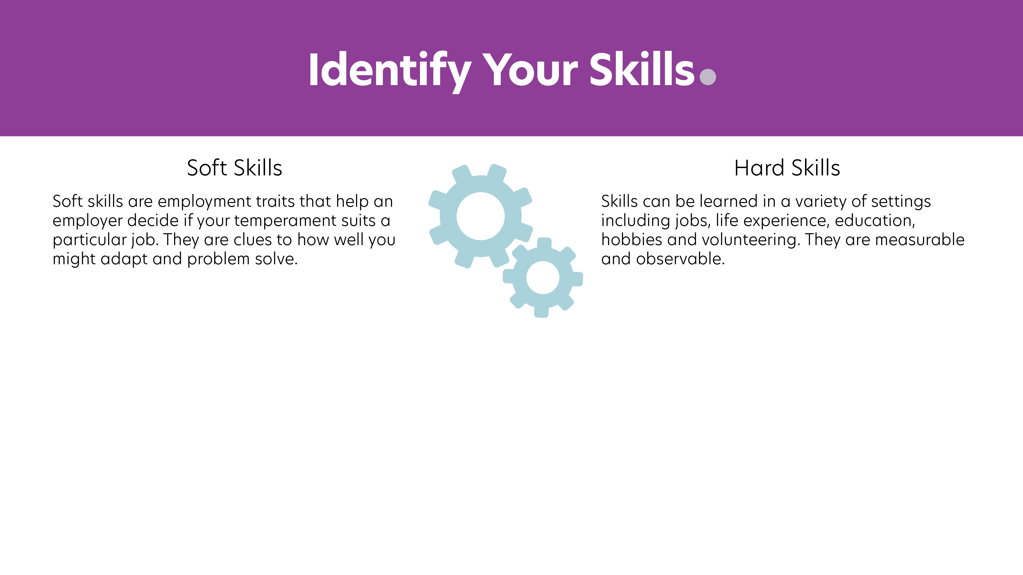
Examples include:
People skills
Communication skills
Time management
Honesty
Punctuality
Motivation
Examples include:
Typing 45 wpm
Folding four towels per minute
Developing websites
Managing projects
Writing technical specs
Notes:
Choose an activity that will help students personalize this information. There are some possible activities in the activity lists.
Understanding your soft and hard skills are important aspects of finding and maintaining employment. Once you can identify what your skills are, you can understand what skills need improvement.

Slide 3

Employers can teach you hard skills
Employers expect you to have soft skills
Often people lose jobs due to lack of soft skills
Notes:
Employers can teach you hard skills but they expect you to have the soft skills.
While employers often look for hard skill when looking to hire someone, it is usually the lack of soft skills that will get you fired from a job.
Hard Skills examples
Typing speed
Machining skills
Speaking a foreign language
Cash register experience
Kitchen skills (food safety, knife skills, etc)
Knowledge of computer programs such as excel, word, power point

Slide 4

Employers want people who are:
Productive and hard working
Good communicators
Positive
Reliable
Flexible
Professional
Problem solvers
Responsible
Detail oriented
People oriented
Notes:
Understanding your soft and hard skills are important aspects of finding and maintaining employment. Once you can identify what your skills are, you can understand what skills need improvement.
Hard Skills are measurable and observable such as:
Typing 45 wpm
Folding 4 towels per minute
Soft Skills are more subjective and relate to people skills such as:
Getting along with others
Communication skills

Slide 5


Ambitious
Eager
Efficient
Resourceful

Slide 6


Listen well
Speak well
Tactical

Slide 7


Helpful
Humorous
Optimistic

Slide 8


Punctual
Good attendance
Works well under pressure

Slide 9


Open minded
Patient
Practical
Resourceful

Slide 10

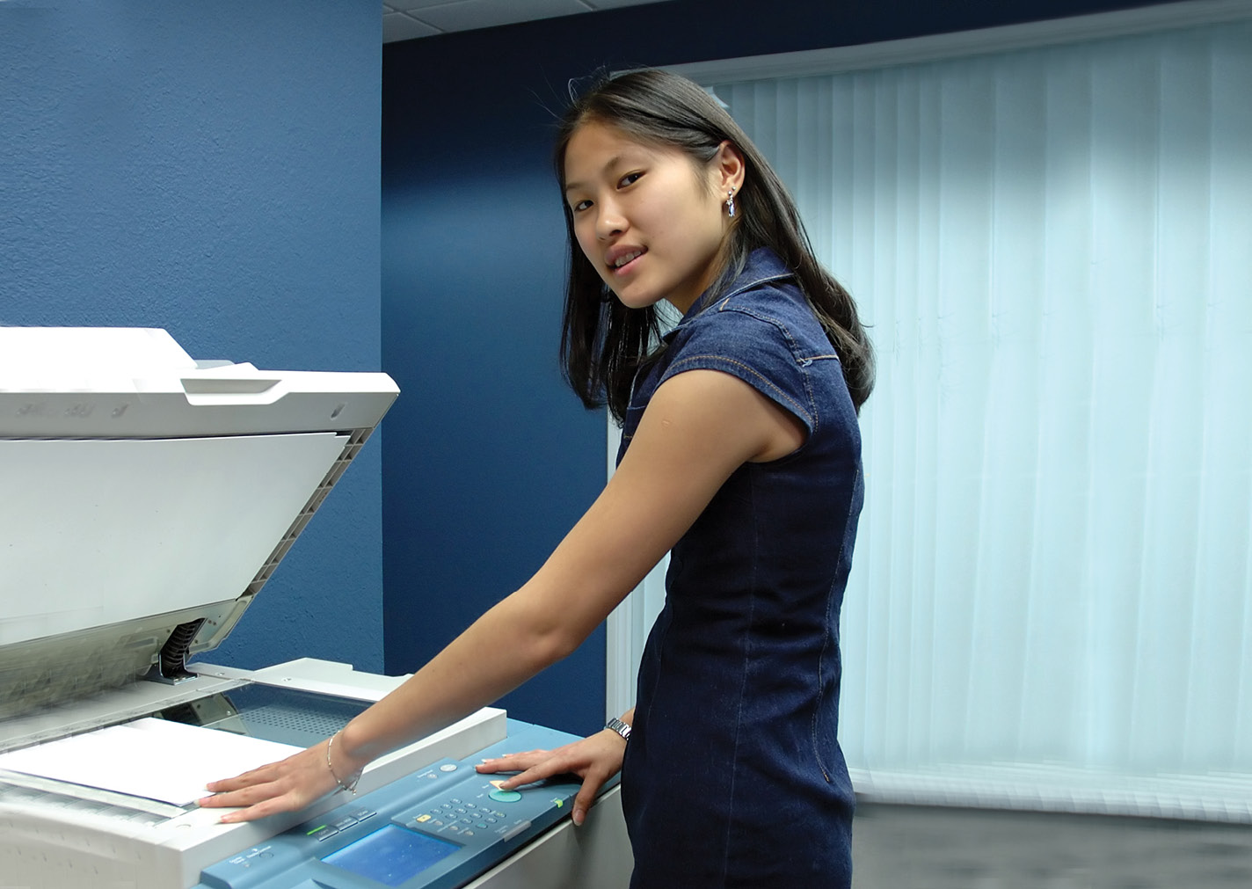
Respectful
Trustworthy
Sincere
Strong work ethic

Slide 11


Conflict resolution
Tenacious
Competent
Organized

Slide 12


Follow directions
Results oriented
Thrifty
Persistent

Slide 13

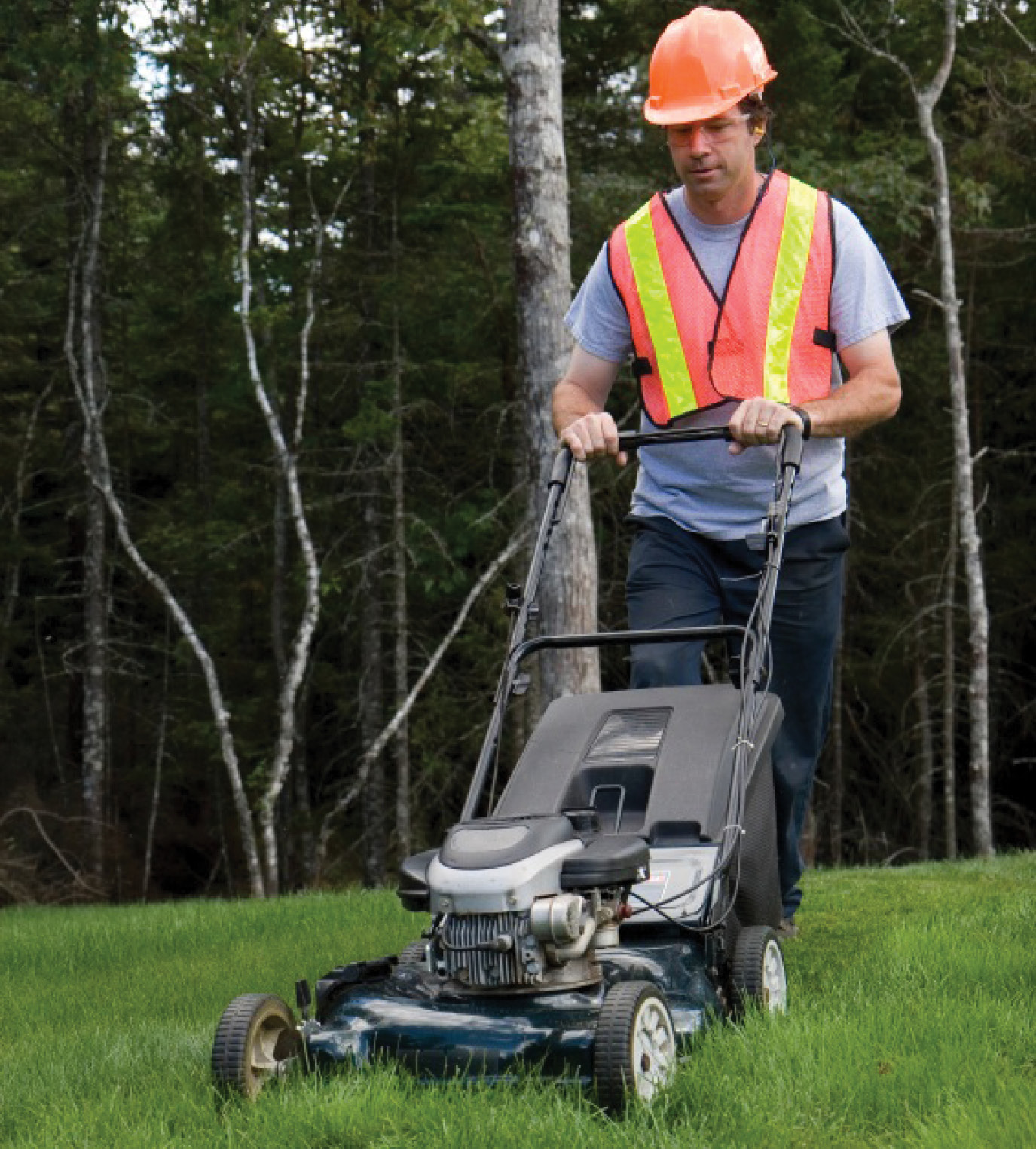
Methodical
Research
Creativity

Slide 14


Cooperative
Team player
Friendly

Slide 15


Individualized counseling and guidance
Provide activities that can help identify your current skills and ways to gain needed skills

Slide 16

Are there hard and soft skills I need to improve or develop?
What are some barriers that I will need to overcome, or need assistance to overcome, in order to reach my goals?
Notes:
*Direct them to their Student Workbooks and go over the Reflection Questions…..
Additional questions that could be discussed if needed: What will I gain or how will my life change if improve certain skills?
Are there barriers that might exist to improving in certain skills and what will I need to do to overcome these barriers? (Disabilities related issues, financial issues, support issues)
Who will be your cheerleader? Someone who will support you in reaching your goal? (teacher, parent, friend, VR Counselor)

Slide 17

Questions?
Name and email:

Slide 18


