Slide 2
Personal Hygiene
Grooming
Clothes
Posture
Body Language
Actions
Notes:
Discuss Personal Image and Hygiene. Handout Personal Image Checklists for students to complete now or later and reflect on their own image. (This checklist is in the Student Workbook appendix)
-Remember, your impression begins when you arrive at the company. How you act in the parking lot, when speaking to the Receptionist, or to others in the lobby, as well as to the employers may determine whether or not you get the job!

Slide 3
Comb hair
Shave or trim beard
Smile
Show confidence
Shake hands
Dress well
Clean and press clothes
Stand up straight

Slide 4
Good hygiene and grooming – this is part of making a good impression
Clothing – wear the nicest clothing you can
Good posture – this is a sign of confidence
Smile! – this is also a sign of confidence
Notes:
Discuss what Making A Good Impression means. Why does this apply to students?
Brush teeth twice daily
Shower daily and use deodorant
Shave and wash hair regularly
Wash hands regularly to avoid dirty fingernails/hands
If you are sneezing or coughing, stay home
Do not smoke unless you are on break outside

Slide 5
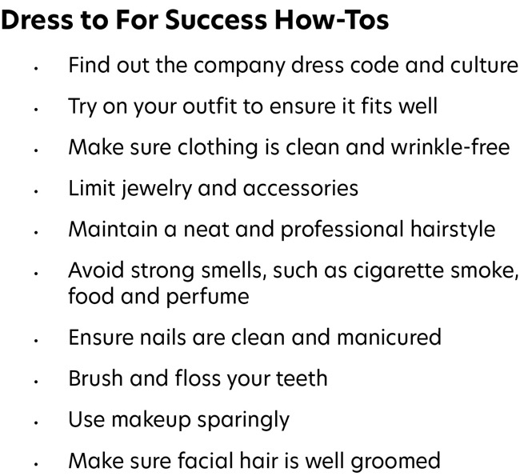
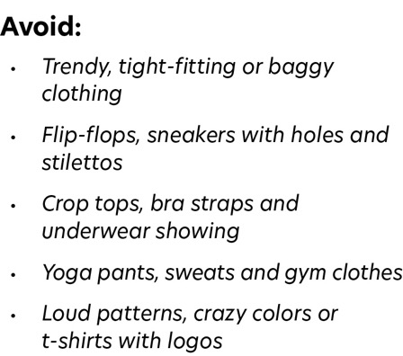
Notes:
Smell — be aware of body odor, bad breath, gas, or perfume/cologne that is too strong
Bad habits: avoid picking your nose, biting your nails, popping pimples or other similar habits

Slide 6
Who would you hire or promote?
Why?

Slide 7
First impressions are important
Make a positive impression; find out the company’s dress
If you can’t find out ahead of time, then dress up a notch above what’s appropriate for the industry
Your interview outfit should communicate confidence, a high work ethic and a good fit with their culture

Slide 8
Notes:
Most employees in traditional industries, such as banking and finance, dress in more formal attire.

Slide 9
Notes:
Many companies prefer this style — slightly more formal than casual dress but less formal than business professional.
Discussion: what not to wear. Sloppy pants, t-shirts, shorts, holes in pants, sweatshirts, PJs, etc.

Slide 10
Notes:
Casual Attire
More and more companies are opting for casual attire. This does not mean you can throw all standards out and wear anything you want. Your clothes still need to be professional and appropriate for the workplace.
Note on uniforms: no holes, stains or wrinkles. Washed with correct shoes, tools, and gloves and hat if needed.

Slide 11
Making a good impression includes:
Communicating well
Listening
Asking questions
Making eye contact
Using positive body language
Notes:
Be prepared to shake hands, with a firm, welcoming grip and give a smile and head nod, elbow bump or wave when introduced in lieu of a handshake.
When you sit, maintain good posture with your head up and your back straight. Do not slouch; this can make you look sloppy and uninterested.
Sit comfortably and not too stiff which can make you look nervous or uptight.
Keep your arms open and be aware of what you are doing with your hands. The best place to put your hands is loosely clasped on the table in front of you or in your lap. Consider bringing a notepad or padfolio to job notes during the interview.
Maintain good eye contact and lean in slightly to show interest.
Make eye contact when you shake hands. If more than one person is interviewing you, make eye contact with everyone the same as you would during a group conversation.
Maintain eye contact that is natural or comfortable and keep an interested expression that is natural and relaxed. Nod and smile when it is appropriate.
Be aware of nervous body movements and keep them in check — don’t rock in your chair, drum your fingers, play with your hair, bite your lip, rub or touch your nose or click your pen.

Slide 13
Twisted
Put your hands out in front of you and clap and miss, leaving your arms crossed.
Put your thumbs down and then put your hands together.
Pull your hands inward, rolling them towards you until your hands are on top and your elbows are hear your side.
Put your right leg over your left leg.
Now switch your legs and put your left leg over your right leg.
Spell your first name backwards.
Spell your last name backwards.
Uncross your legs and unwind your arms.

Slide 14
Am I communicating what I want?
Keep an interested expression and smile
Remain calm
Practice your handshake
Notes:
Bad posture vs good posture. Standing up with shoulders back helps you appear more confident, lets you bring in oxygen easier and even look slimmer. Do not slump your shoulders forward.
Do not: yawn, fidget, put feet up on desks or tables, send text messages or do anything on your phone. Do not slump forward when sitting, cross your arms as if angry, or look away as if bored and daydreaming.

Slide 16
Questions?
Name and email:

