Slide 1


Slide 2

My name is:
My email is:

Slide 3

Key Vocabulary
Role play: How to Advocate for things you need
Role play: Social Introductions
IEP Owner’s Manual game
Review

Slide 4


Slide 5

Individualized Education Program (IEP) — roadmap to help students reach their goals
Accommodations — how the school adapts or changes instruction so a student is able to access learning
Individuals with Disabilities Education Act (IDEA) – requires the schools provides a free and appropriate public education and related services to all eligible children
Transition/Pre-Employment Transition Service ({re-ETS) – a section of the IEP that addresses services a student may need to meet their postsecondary goals

Slide 6
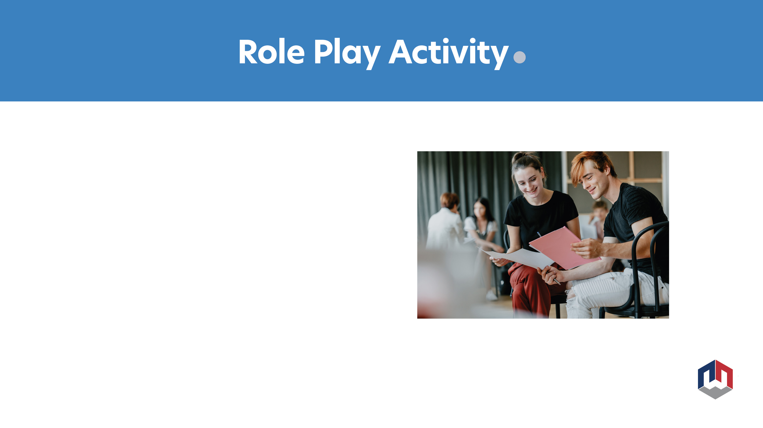
How to advocate
for things you need:
  Cell phone, speech to text, breaks, and more

Slide 7

Scenario
You are going to be introducing the members of your IEP team at your next IEP meeting.

Slide 8

Identify the parts of the IPE and what is in each section.
Use the manual provided to complete during this activity.

Slide 9

Stand up
Put your arms out in front of you with your hands clasped together. Try to keep your elbows straight.
Keeping your hands together, slowly move your arms to the left and then to the right as far as you can.
Now, try doing the steps while standing on one leg to see if you can balance.

Slide 10

Talk about why it is important to attend your IEP and let your team know what your needs are.

Slide 11

Questions?
Name and email:

Slide 12


