Slide 1


Slide 2

My name is:
My email is:

Slide 3

Key vocabulary
Job Interview Checklist
Interview Questions Game
Role play: Mock Interviews
Discussion and Review

Slide 4


Slide 5

Job experience – the skills you gain from working
Skill gain – an increase in ability that comes from practice and repetition
References – people who are willing to talk about you to a potential employer

Slide 6
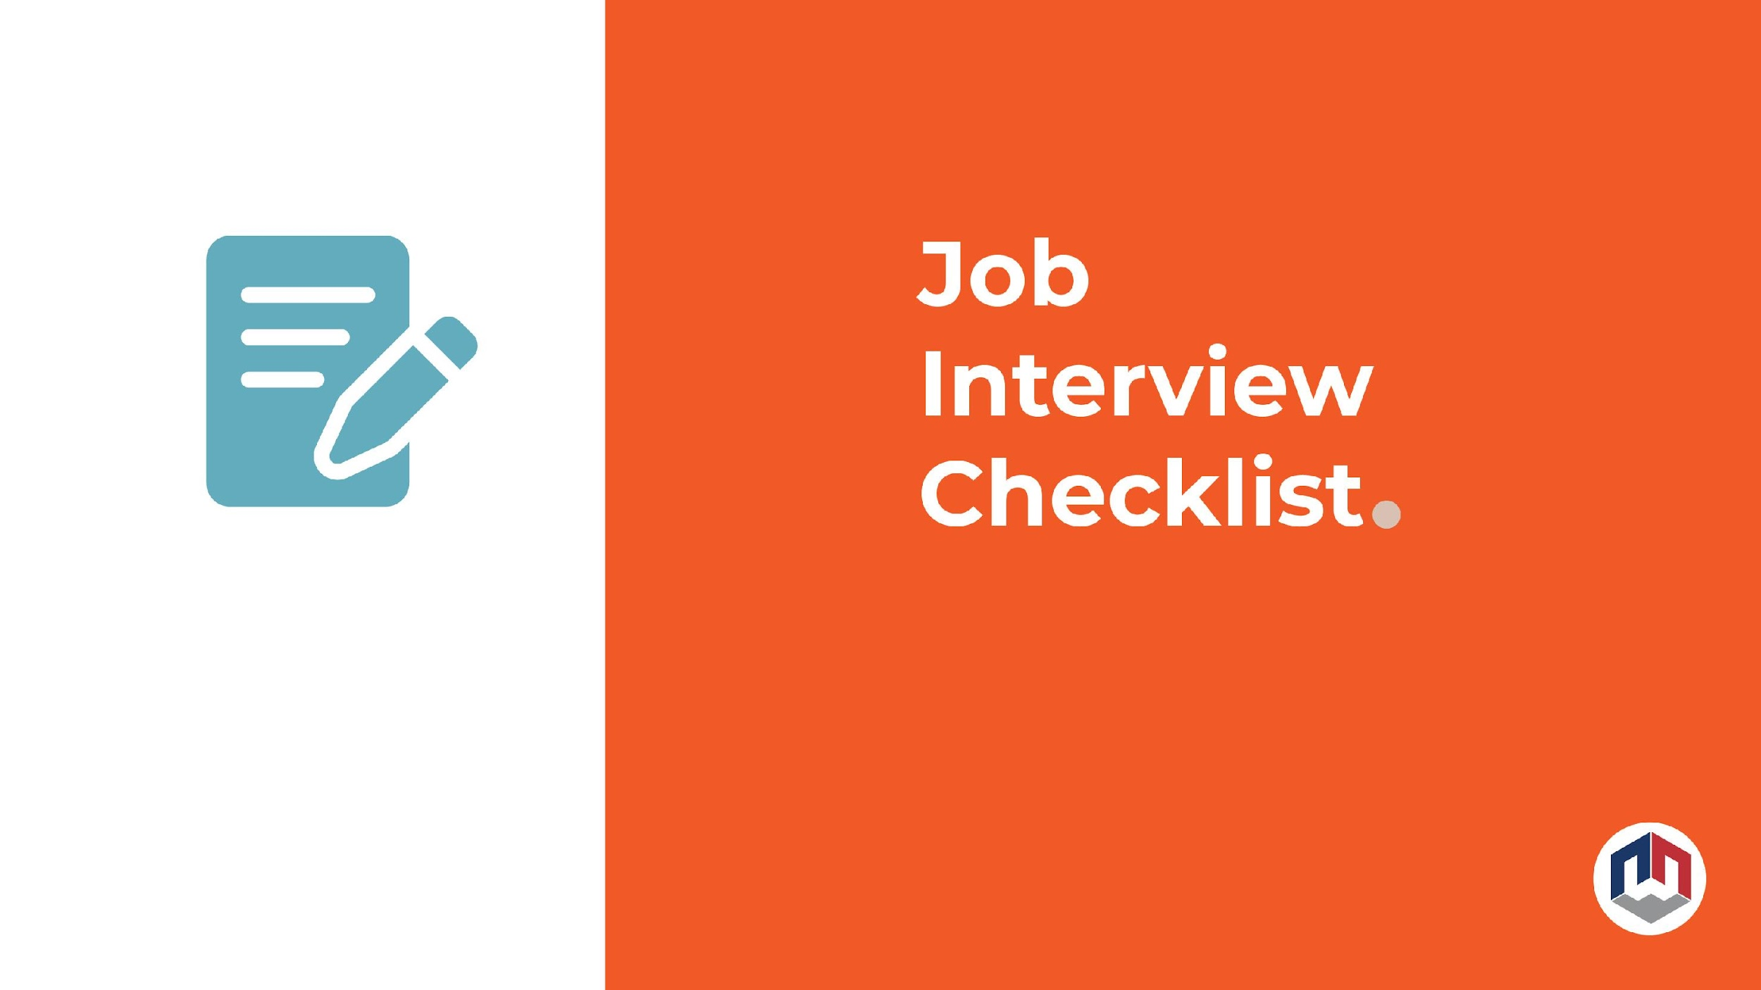

Slide 7
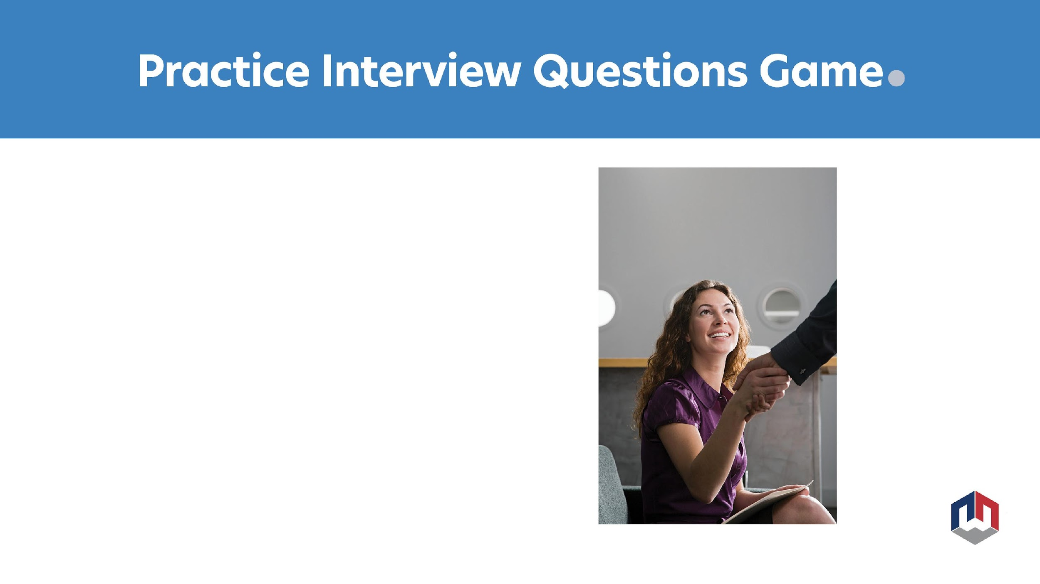
Play Jenga and answer the interview questions on the blocks as you play.

Slide 8
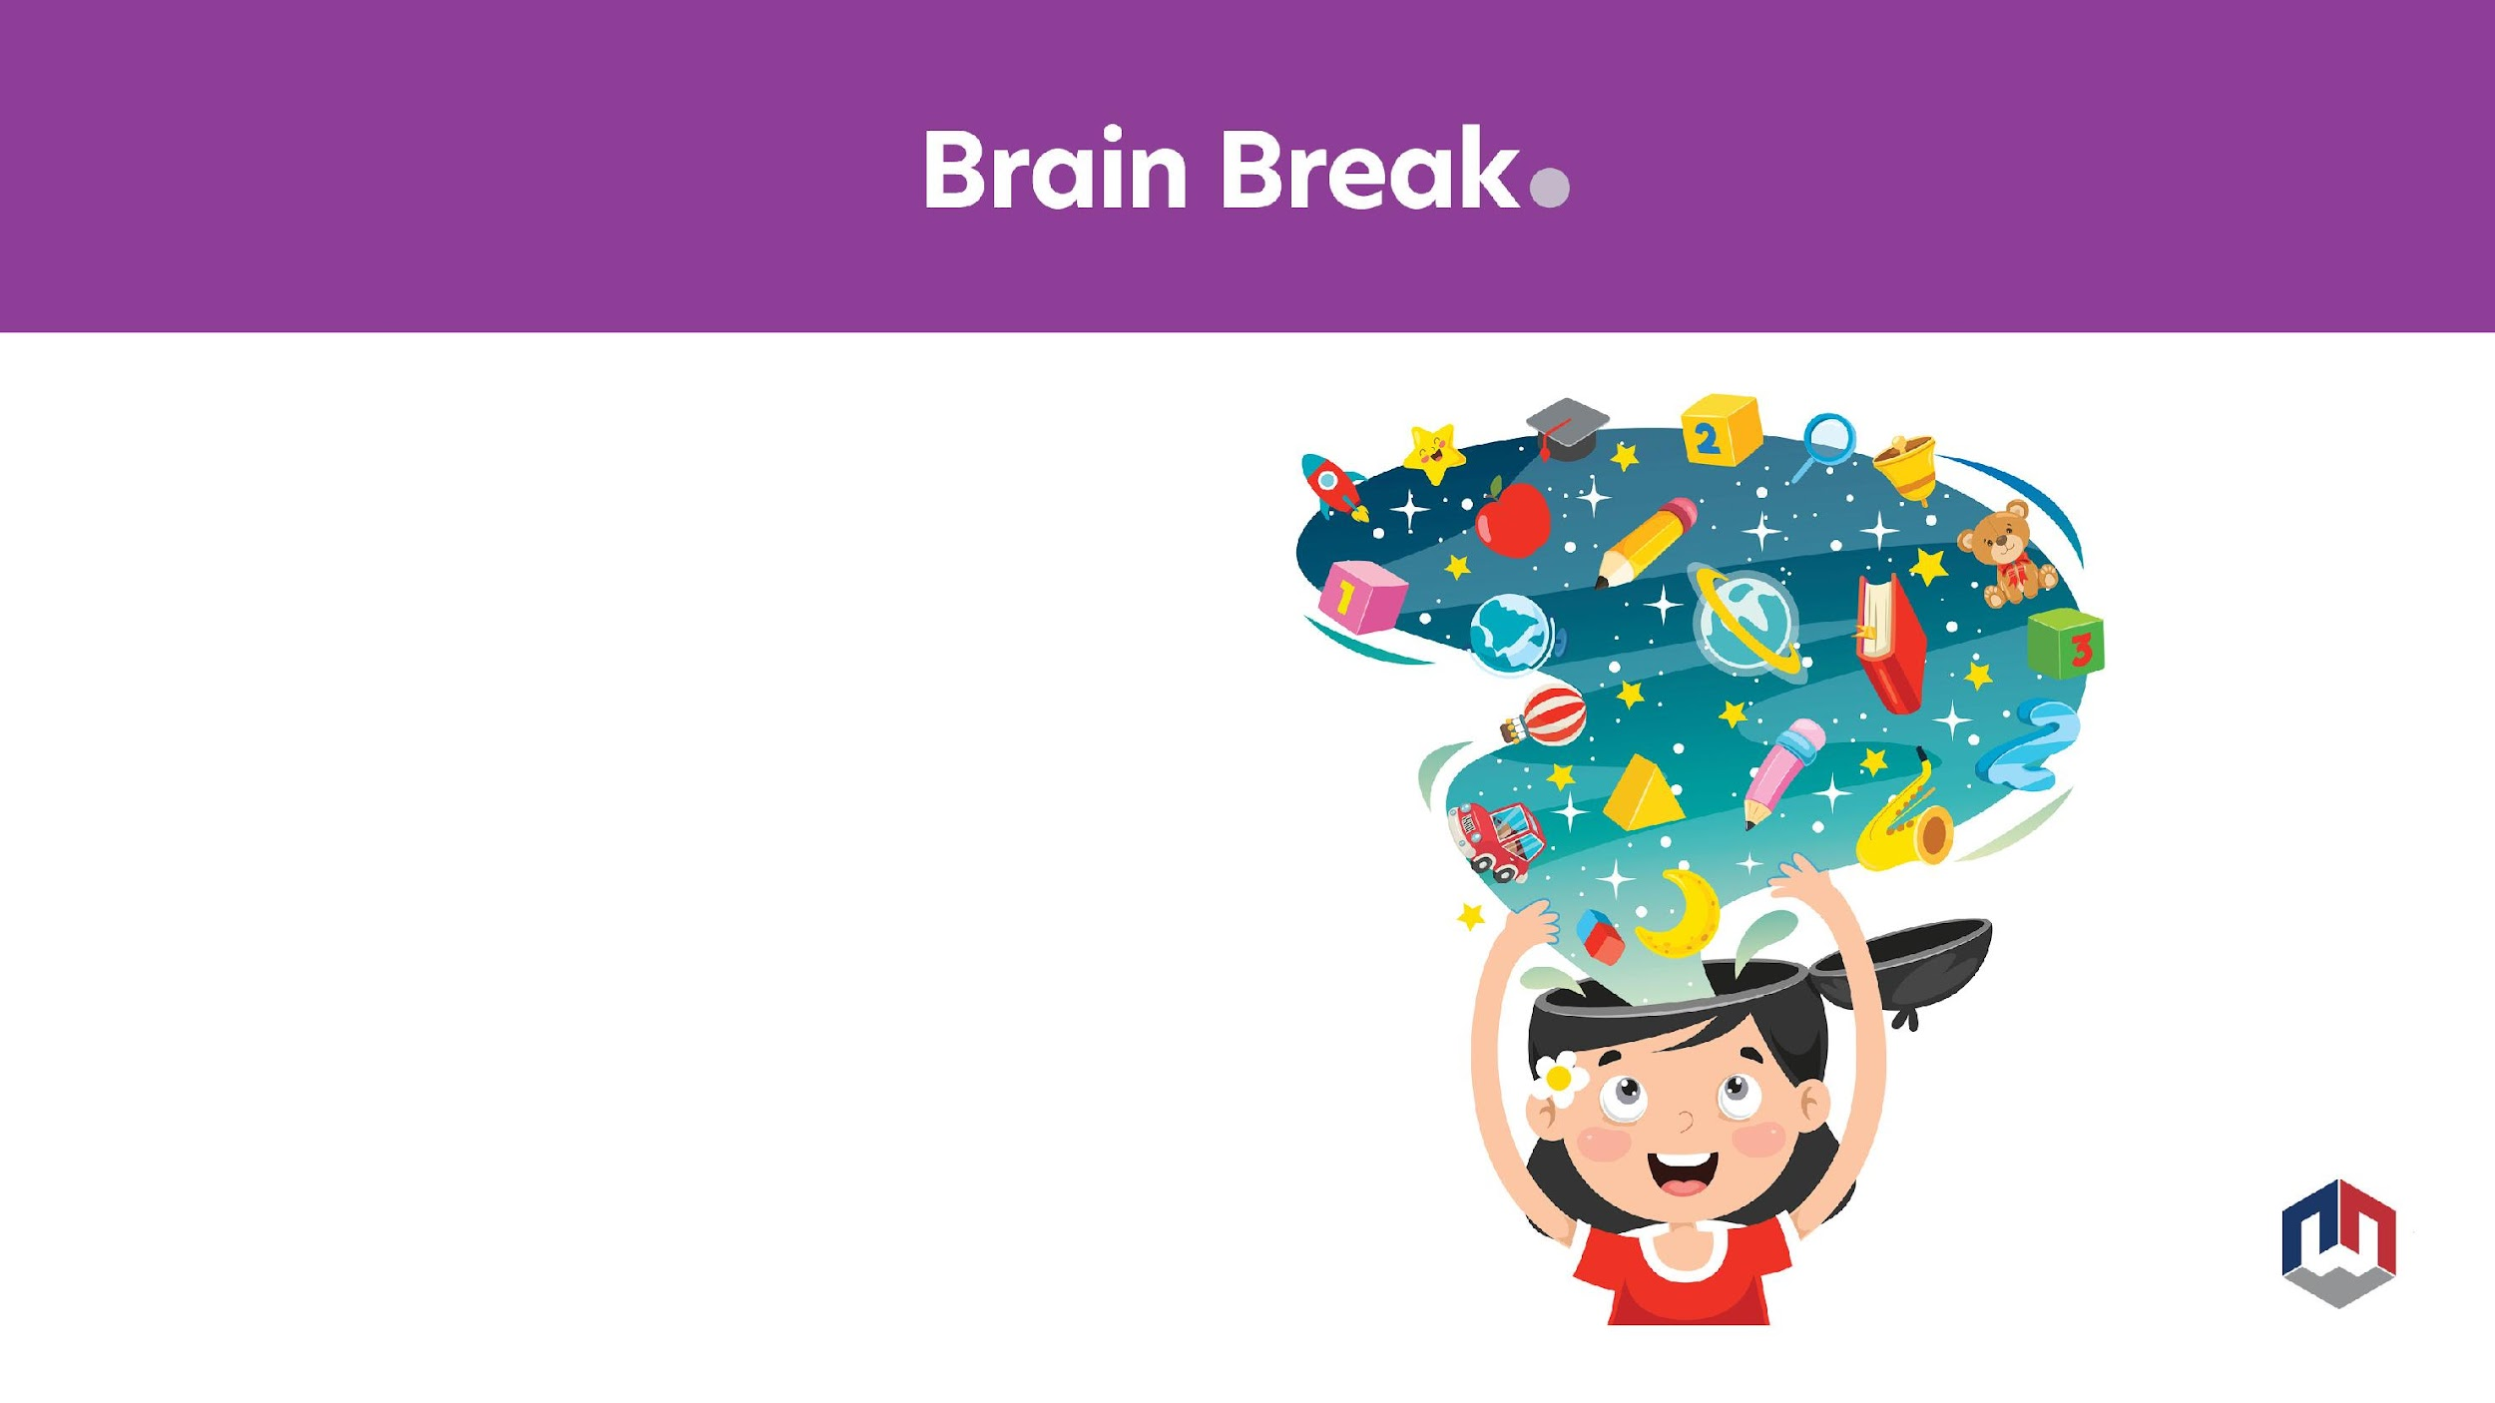
Right on left balance
Stand up
Put your right foot on top of your left foot
Try to balance this way for 20 seconds. If this is easy, bend down and try to touch your right hand to your right foot without bending your knees during the 20 second count.
Switch and put your left foot on top of your right foot and hold for 20 seconds. Try bending down if you can.

Slide 9
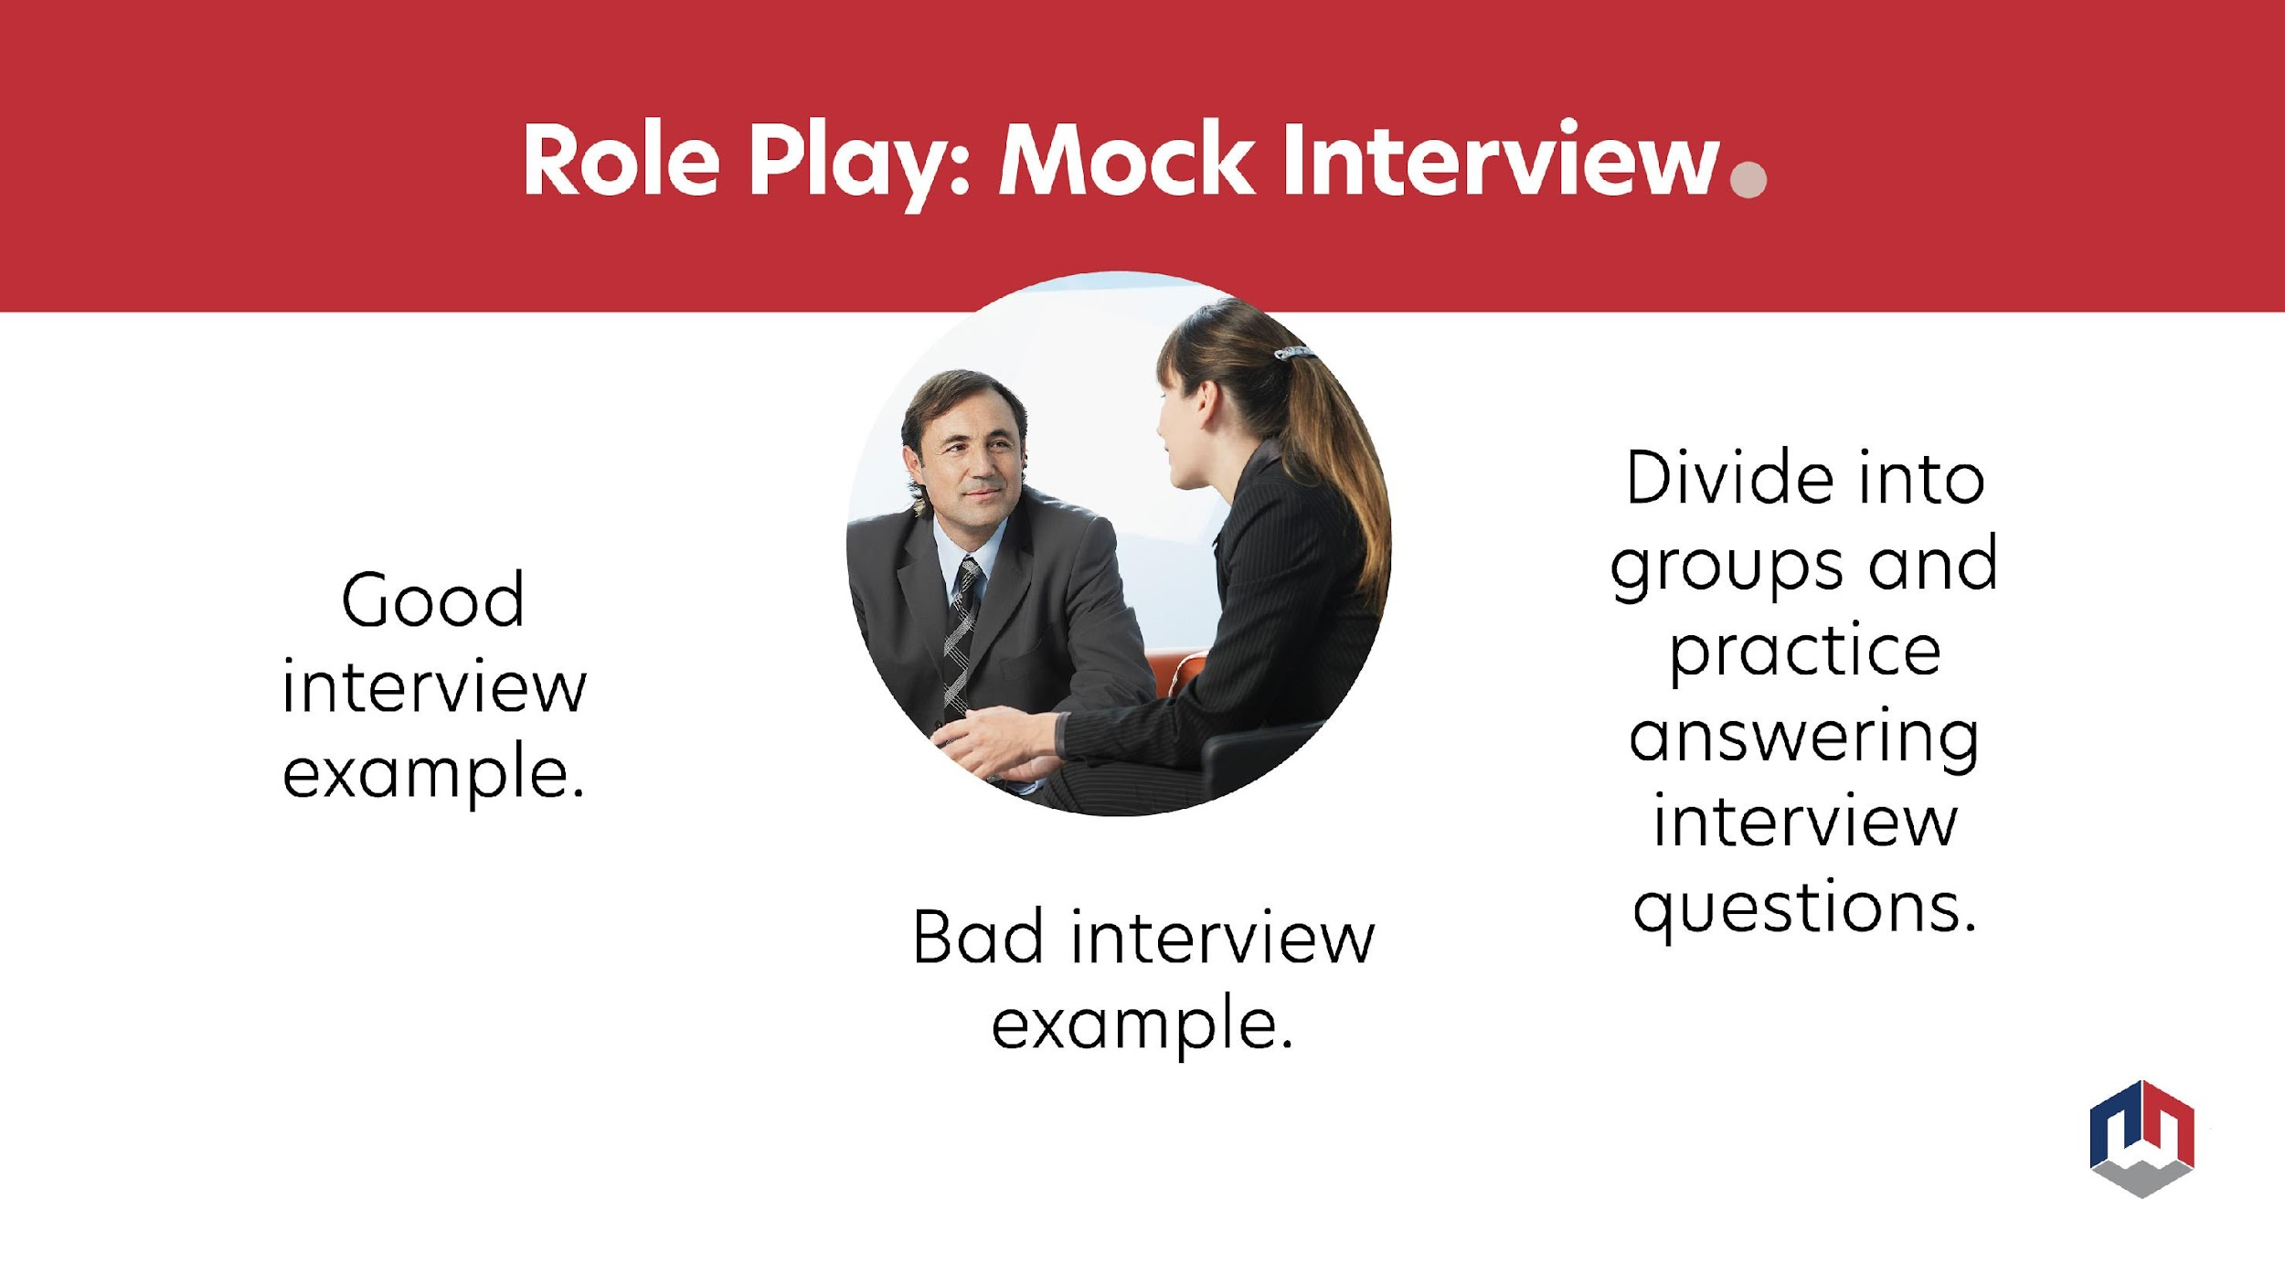

Slide 10


Give feedback on mock interviews.

Slide 11
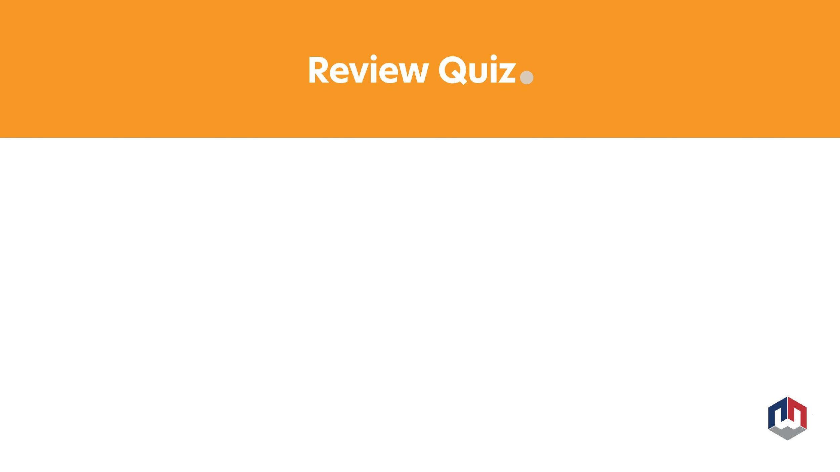

Stepping stones or career pathways

Slide 12
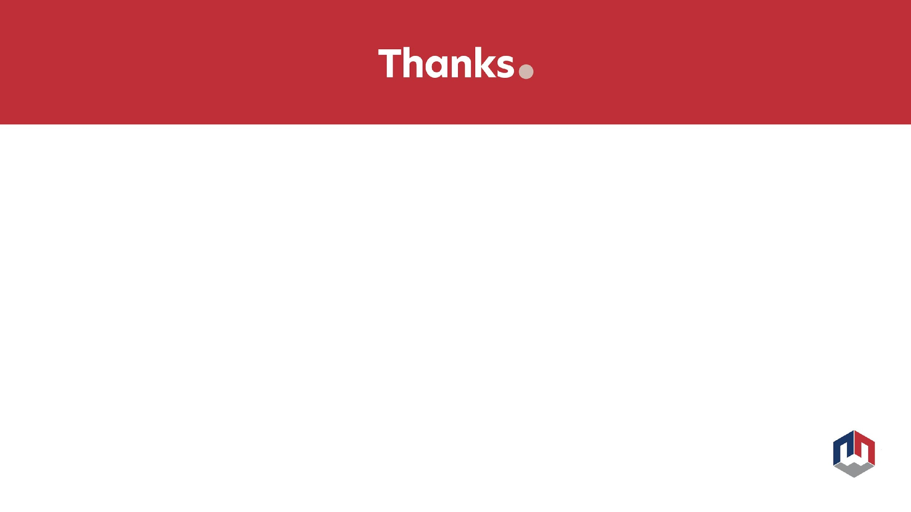
Questions?
Name and email:

Slide 13


