Slide 1


Slide 2

My name is:
My email is:

Slide 3

Key Vocabulary
Video: Disclosing Your Disability is up to You
Role play: Disability Disclosure
Matching game
Disclosure book
Review quiz

Slide 4


Slide 5

Disability disclosure – sharing information about your disability in order to receive accommodations
Sensitive information – data that needs to be protected to keep your identity protected
Personal information – relates to your name, health, finances, education, business, use of government services, address, phone number, social security numbers, driver’s license numbers, and financial information
Self-determination – the desire, ability and practice of directing your own life and making your own decisions

Slide 6


Slide 7
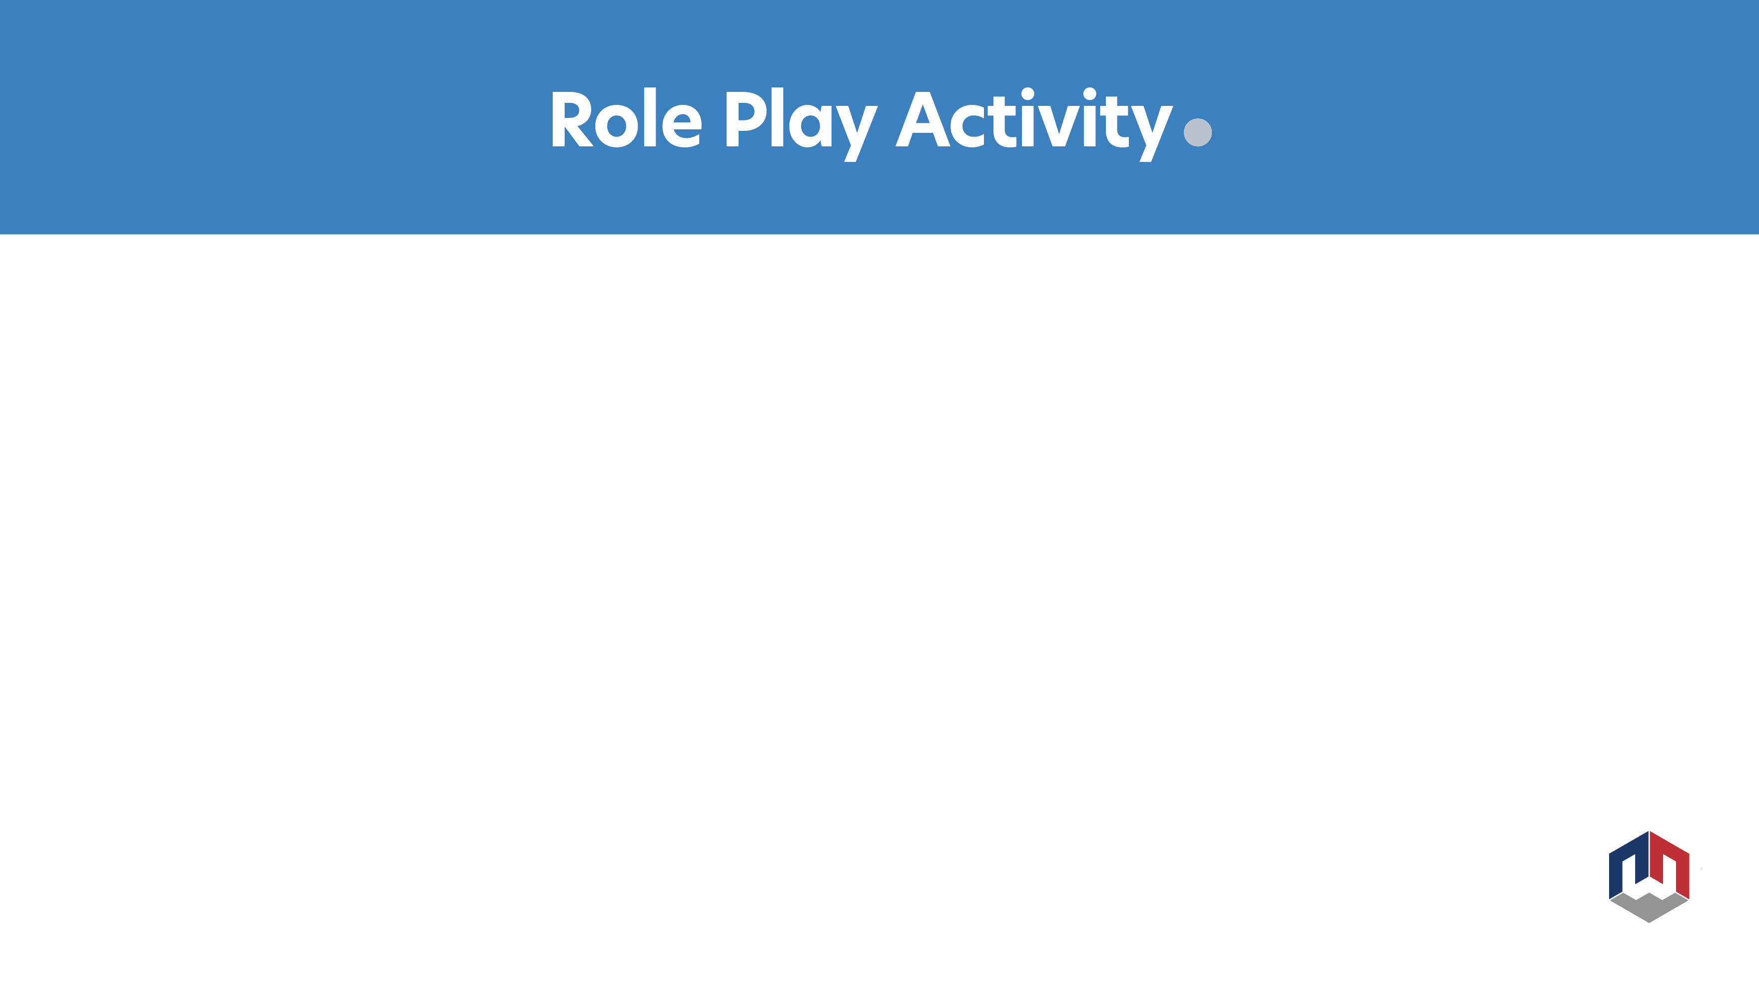

Scenarios
You are faced with the choice of whether or not to disclose your disability and the possible outcomes of your decision.

Slide 8


Match the accommodations to disabilities.
Be sure that the accommodation will help the student perform the work task.

Slide 9

The Wave (group activity)
Figure out a path through the class with starting and ending points.
Stand up
The first person claps once
The second person claps twice
The third person claps once
And the pattern continues until you get to the end of the line.
Pick another person to be the starting point and decide on a new pattern
Be creative with your clapping patterns and see how long the group can keep each pattern going. You will need to pay attention to what the person before you did in order to keep the pattern going.

Slide 10

Getting Ready to Disclose Worksheets

Slide 11



Slide 12

Questions?
Name and email:

Slide 13


